Slide 1

Notes:
[Provide introductory remarks, set the tone/introduce yourself and your relation to the audience.]
“Next Slide”

Slide 2

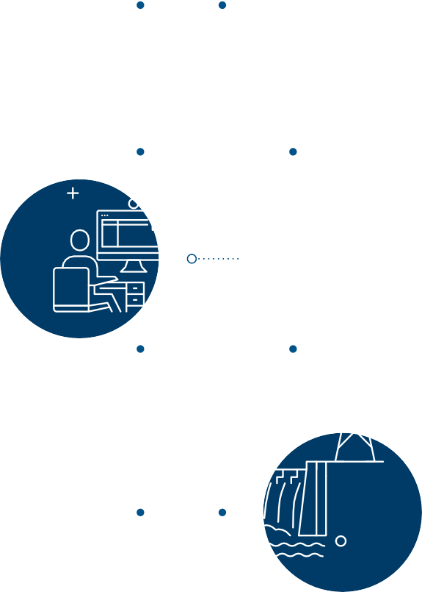
Cybersecurity and
Infrastructure Security Agency (CISA)
As America’s Cyber Defense Agency and the National Coordinator for critical infrastructure resiliency and security, CISA leads the national effort to understand, manage, and reduce risk to the cyber and physical infrastructure that Americans rely on every hour of every day.

Slide 3
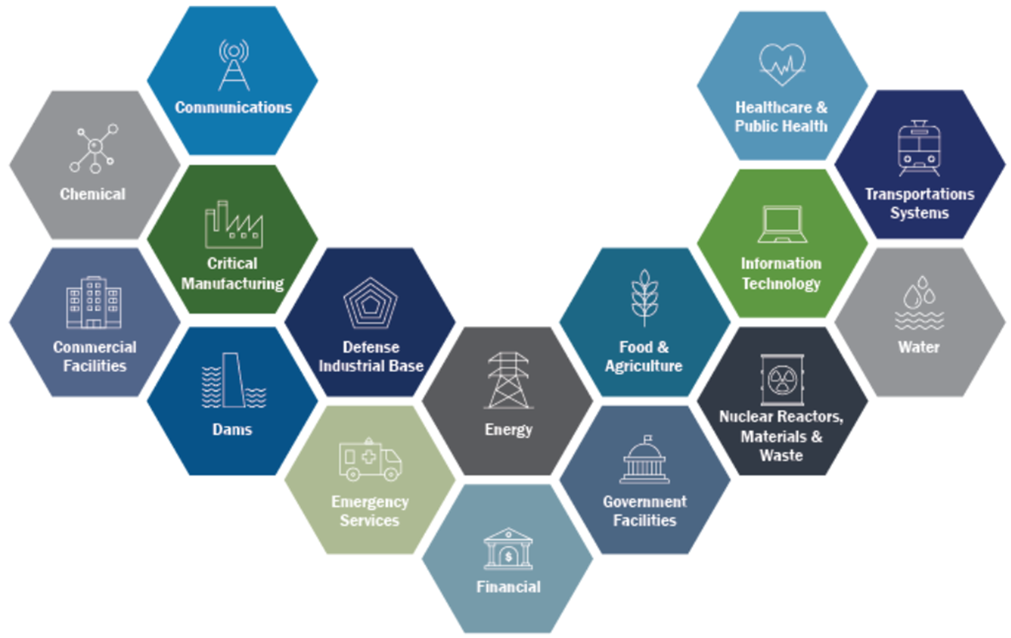
Critical Infrastructure
CISA assists the public and private sectors in managing risk to critical infrastructure.

Slide 4
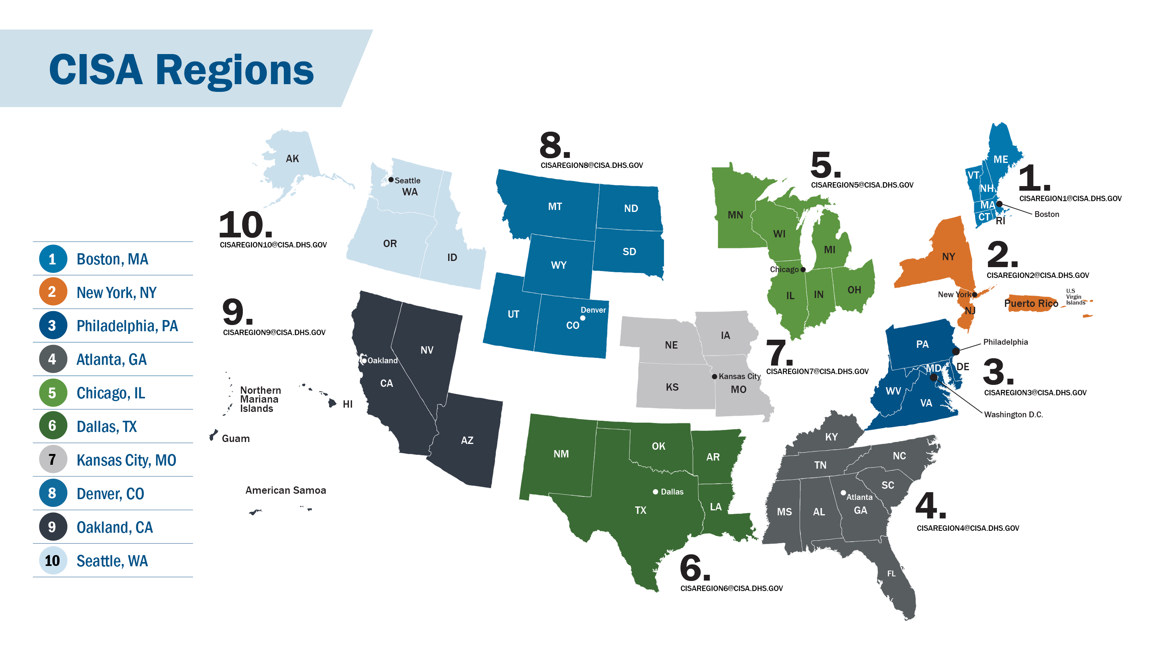

Slide 5
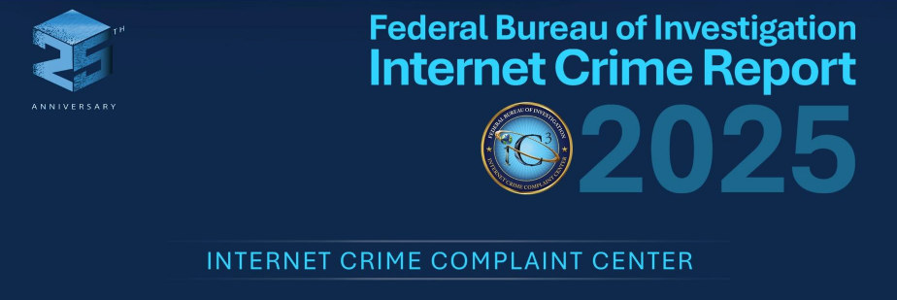
FBI Internet Crime Report 2025
Collection
Analysis
Referral & Enhancement
Coordination
Public Awareness

Slide 6
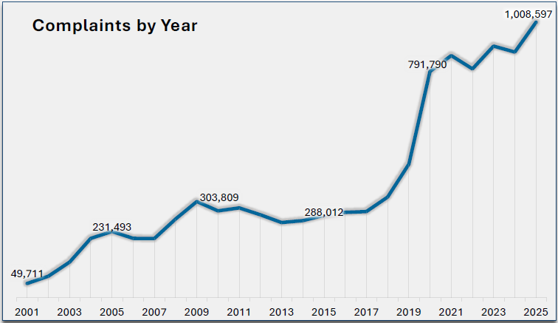
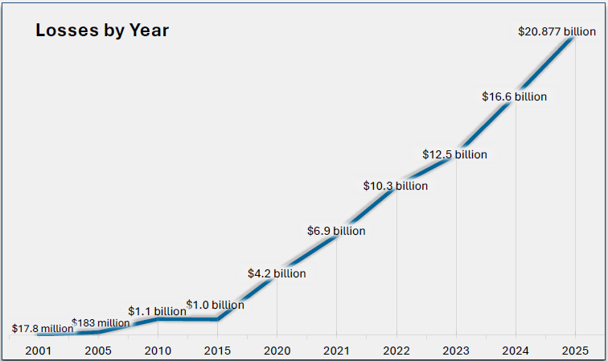
Internet Crime Complaint Center (IC3) Quarter Century

Slide 7
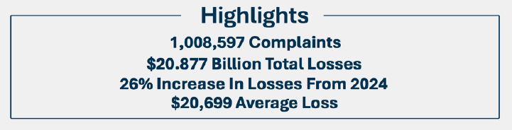
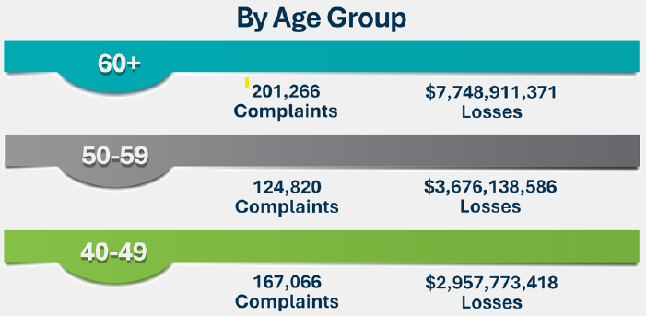
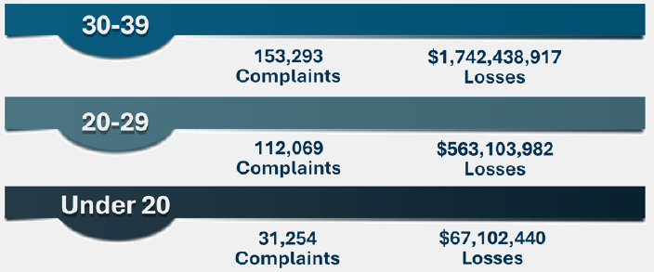
Internet Crime Complaint Center (IC3) 2025 By The Numbers
FBI 2024 IC3 Report
ic3.gov/AnnualReport/Reports/2025_IC3Report.pdf

Slide 8
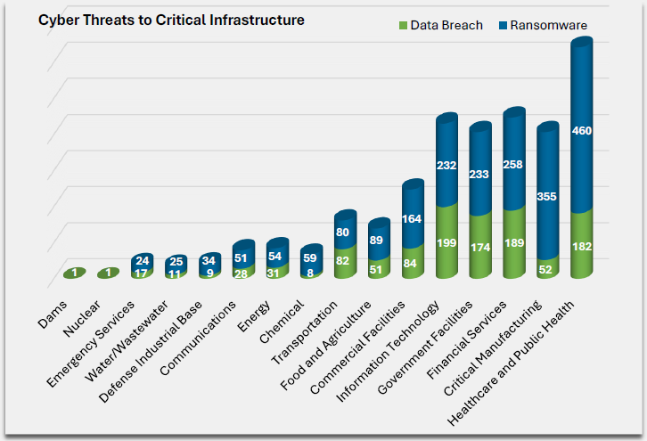
2025 IC3 Critical Infrastructure
ic3.gov/AnnualReport/Reports/2025_IC3Report.pdf

Slide 9
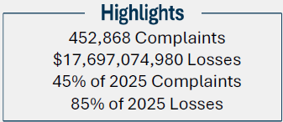
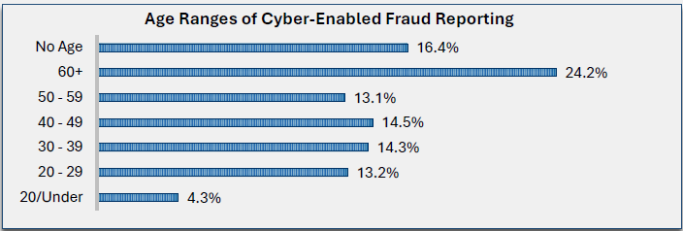
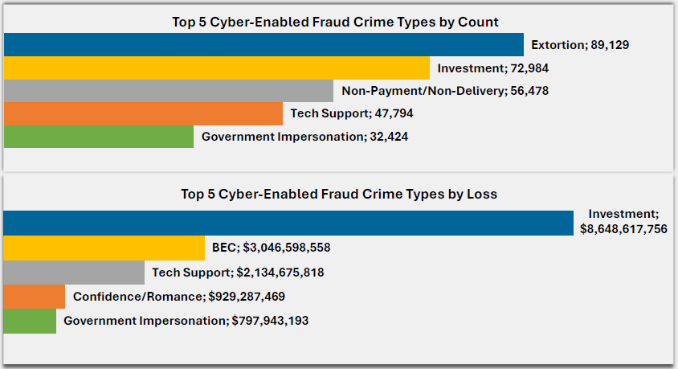
2025 Cyber-Enabled Fraud

Slide 10
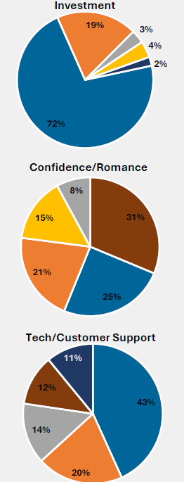
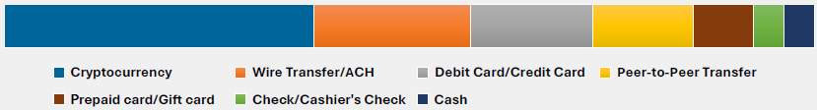
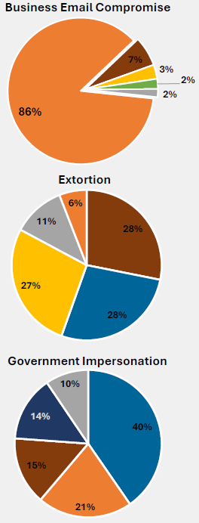
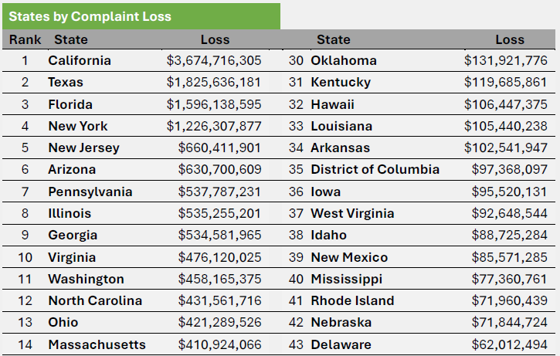
Top Reported Transaction Types in Fraud

Slide 11
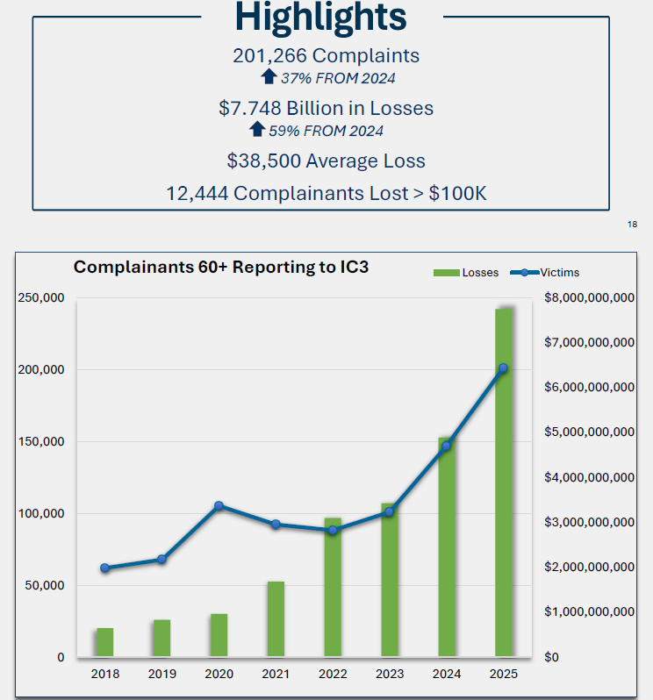
Elder Fraud – Individuals 60+

Slide 12
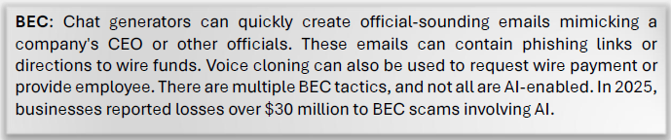
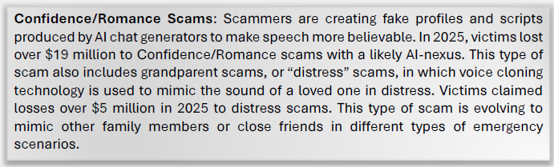
How AI Could Be Used in Fraud/Scams

Slide 13
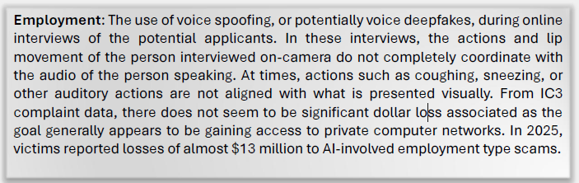
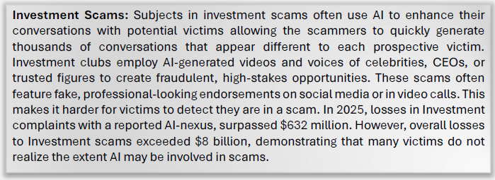
How AI Could Be Used in Fraud/Scams

Slide 14
Common Types of Scams
Blackmail scams
Charity scams
Debt collection scams
Debt settlement and debt relief scams
FDIC logo misuse
Foreclosure relief or mortgage loan modification scams
Grandparent scams
Impostor scams
Unpaid Tolls
Lottery or prize scams
Mail fraud
Man-in-the middle scams
Money mule scams
Money transfer or mobile payment services fraud
Mortgage closing scams
Romance scams
Sale of nonexistent goods or services scams

Slide 15
Romance Scams – How to Protect Yourself
Be careful what you post and make public online. Scammers can use details shared on social media and dating sites to better understand and target you.
Research the person’s photo and profile using online searches to see if the image, name, or details have been used elsewhere.
Go slowly and ask lots of questions.
Beware if the individual seems too perfect or quickly asks you to leave a dating service or social media site to communicate directly.
Beware if the individual attempts to isolate you from friends and family or requests inappropriate photos or financial information that could later be used to extort you.
Beware if the individual promises to meet in person but then always comes up with an excuse why he or she can’t. If you haven’t met the person after a few months, for whatever reason, you have good reason to be suspicious.
Never send money to anyone you have only communicated with online or by phone.

Slide 16
Money Mules
Types
Unwitting or unknowing
Solicited in romance scheme or job offer
Asked to use personal account or open a new account
Witting
Bank employees warn of fraudulent activity and continue
Open accounts with multiple banks
Complicit
Want to be mules and make money
Protect Yourself
Perform online searches
Be wary if asked to open a new account
Be suspicious if someone you’ve met online wants to use your account
Never give financial details to someone you don’t know and trust

Slide 17
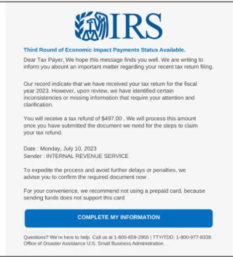
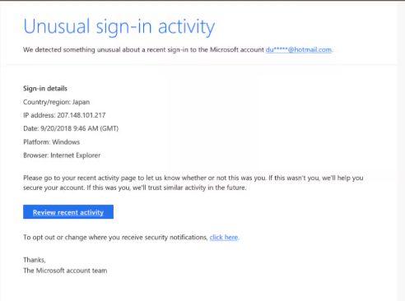
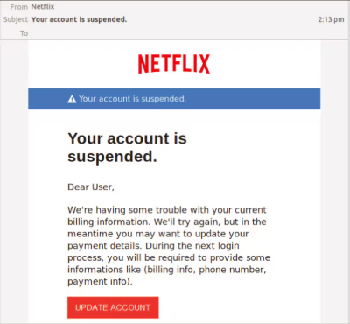
Phishing
Suspicious sender's address. The sender's address may imitate a legitimate business. Generic greetings and signature.
Spoofed hyperlinks and websites. If you hover your cursor over any links in the body of the email, and the links do not match the text that appears when hovering over them, the link may be spoofed.
Spelling and layout.
Suspicious attachments.

Slide 18
How to Identify a Scam
Scammers PRETEND to be from an organization you know.
Federal Trade Commission (FTC), Social Security Administration (SSA), Internal Revenue Service (IRS), Medicare
Local Utility Company, Tech Company (Cox, Microsoft, CenturyLink), Charity
They utilize technology to change the phone number to appear to come from said organization
Scammers say there’s a PROBLEM or a PRIZE.
You are in trouble with the government, you owe money, someone in your family had an emergency, your computer has a virus
Your account has a problem
You won the lottery; pay us a fee to receive it
Scammers PRESSURE you to act immediately.
Want you to act quickly and don’t hang up, threaten arrest, deportation, or other
Scammers tell you to PAY in a specific way.
Only pay via cryptocurrency, wire money through MoneyGram or Western Union, use Venmo or Zelle, or put the money on a gift card

Slide 19
How to Help to Avoid a Scam
Block unwanted calls and text messages.
Take steps to block unwanted calls and to filter unwanted text messages.
Don’t give your personal or financial information in response to a request that you didn’t expect.
Honest organizations won’t call, email, or text to ask for your personal information, like your Social Security, bank account, or credit card numbers.
If you get an email or text message from a company you do business with and you think it’s real, it’s still best not to click on any links. Instead, contact them using a website you know is trustworthy. Or look up their phone number. Don’t call a number they gave you or the number from your caller ID.
Resist the pressure to act immediately.
Honest businesses will give you time to make a decision. Anyone who pressures you to pay or give them your personal information is a scammer.
Know how scammers tell you to pay.
Never pay someone who insists that you can only pay with cryptocurrency, a wire transfer service like Western Union or MoneyGram, a payment app, or a gift card. And never deposit a check and send money back to someone.
Stop and talk to someone you trust.
Before you do anything else, tell someone — a friend, a family member, a neighbor — what happened. Talking about it could help you realize it’s a scam.

Slide 20
Cybersecurity
Do not open email from people you don’t know
Be careful with links and new website addresses
Secure your personal information
Stay informed on the latest cyber threats
Use Strong Passwords
At least 16 characters or more, upper/lowercase, numbers, symbols
Use multifactor authentication whenever possible
Use a password manager
Change default passwords
Keep your software up to date and maintain preventative software programs
Update the operating systems on your electronic devices

Slide 21
Where to Obtain Additional Information
Federal Bureau of Investigations (FBI)
https://www.fbi.gov/how-we-can-help-you/scams-and-safety/common-frauds-and-scams
American Association of Retired Persons (AARP)
https://www.aarp.org/money/scams-fraud/
Federal Trade Commission (FTC)
https://consumer.ftc.gov/scams
Consumer Financial Protection Bureau (CFPB)
https://www.consumerfinance.gov/consumer-tools/fraud/

Slide 22
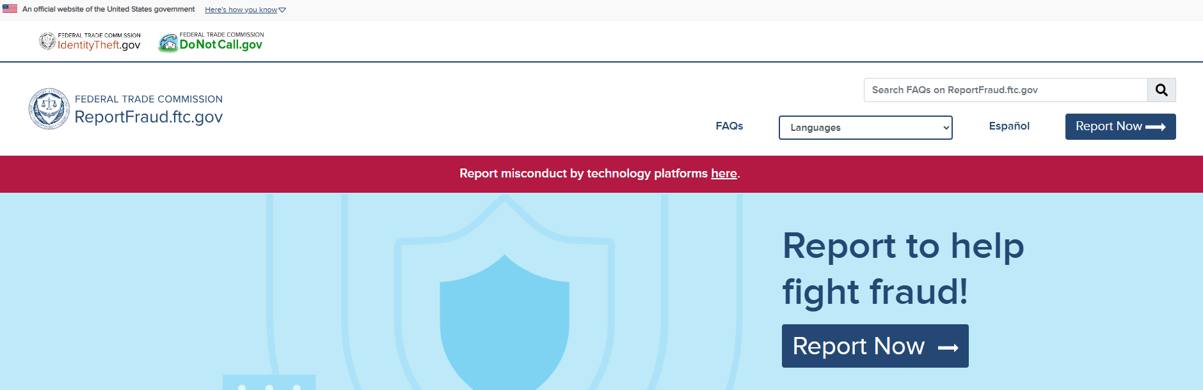
How to Report Fraud - FTC
Federal Trade Commission
https://reportfraud.ftc.gov/

Slide 23
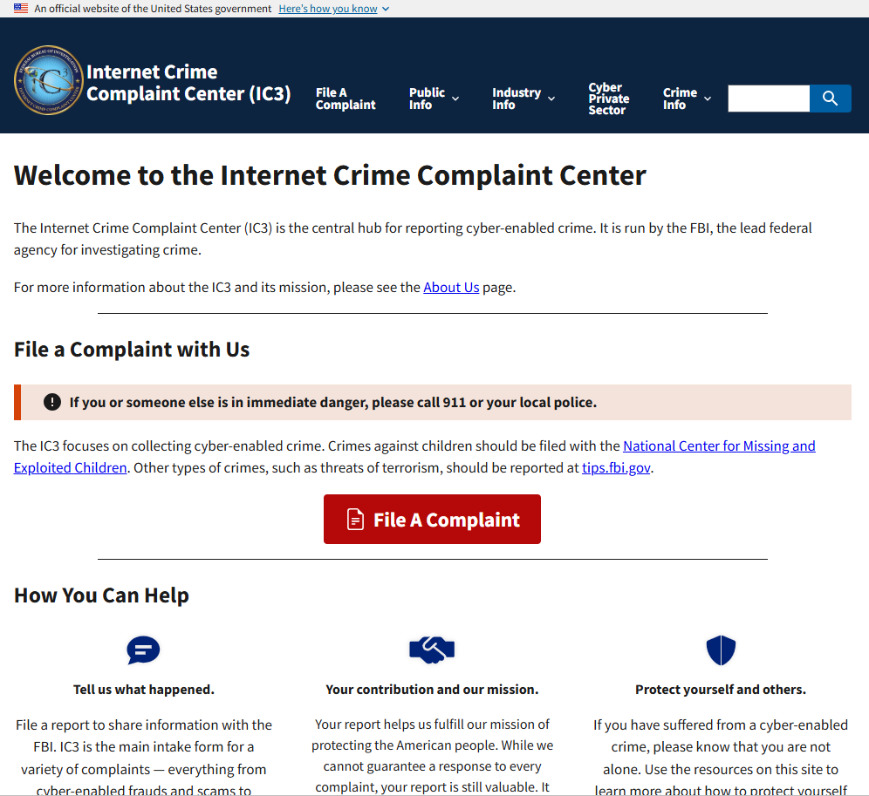
How to Report Internet Crime to FBI
https://www.ic3.gov/

Slide 24
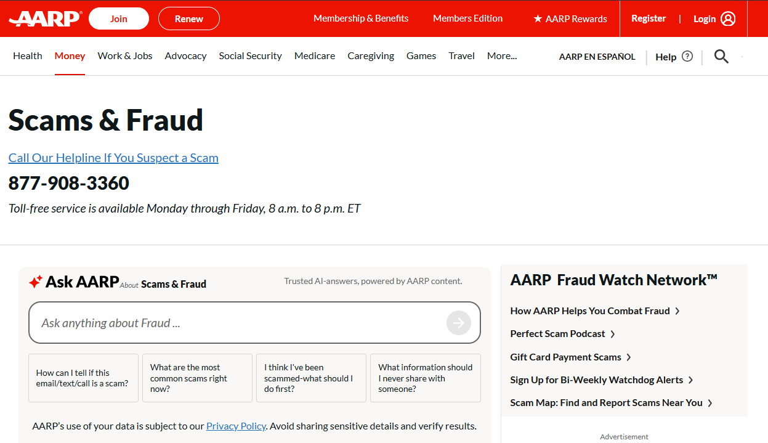
AARP - Helpline

Slide 25

Questions

Slide 26

Region 7 Security Advisors - Nebraska
Nicholas Brand Warren Hagelstien
Cybersecurity Advisor Cybersecurity Advisor
Southern District of Nebraska Northern District of Nebraska
NE State Coordinator Omaha, NE
Lincoln, NE 402-936-1801
402-591-9532 warren.hagelstien@cisa.dhs.gov
nicholas.brand@cisa.dhs.gov
Greg Goodwater Stephanie Brown
Protective Security Advisor Protective Security Advisor
Southern District of Nebraska Northern District of Nebraska
402-785-4116 402-541-3797
gregory goodwater@cisa.dhs.gov stephanie.brown@cisa.dhs.gov
For further information, contact:
CISA.IOD.REGION.R07_Ops@cisa.dhs.gov
Or
contact@cisa.dhs.gov

Slide 27
Cybersecurity Advisors
Chris Cockburn, St. Louis, MO
christopher.cockburn@cisa.dhs.gov 202-689-7871
David Howe, St. Louis, MO
david.howe@cisa.dhs.gov 202-445-7048
Robert Graham, Jefferson City, MO
robert.graham@cisa.dhs.gov 202-705-9949
John Bryant, Kansas City, MO
john.bryant@cisa.dhs.gov 816-634-0528
Protective Security Advisor
Steven Souders, Eastern, MO
steven.souders@cisa.dhs.gov 314-562-2970
Chuck Clanahan, Western, MO
chuck.clanahan@cisa.dhs.gov 785-213-8699
Regional Headquarters
CISARegion7@hq.dhs.gov
CISA Central
SayCISA@cisa.dhs.gov 1-844-Say-CISA

